Slide 1
Data Transformation
Standardization vs Normalization

Slide 2
What Does Feature Scaling Mean?
In practice, we often encounter different types of variables in the same dataset.
A significant issue is that the range of the variables may differ a lot.
Using the original scale may put more weights on the variables with a large range.
In order to deal with this problem, we need to apply the technique of features rescaling to independent variables or features of data in the step of data pre-processing

Slide 3
What Does Feature Scaling Mean?
The goal of applying Feature Scaling is to make sure features are on almost the same scale so that each feature is equally important and make it easier to process by most ML algorithms

Slide 4
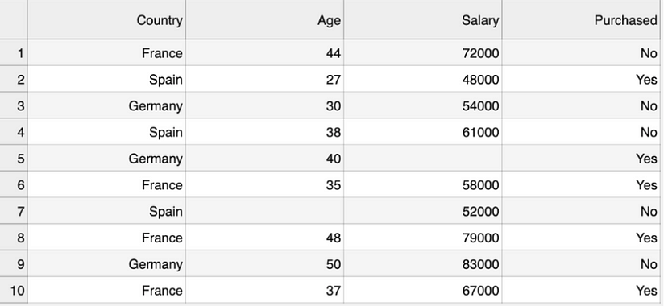
Example
This is a dataset that contains an independent variable (Purchased) and 3 dependent variables (Country, Age, and Salary). We can easily notice that the variables are not on the same scale because the range of Age is from 27 to 50, while the range of Salary going from 48 K to 83 K.

Slide 5
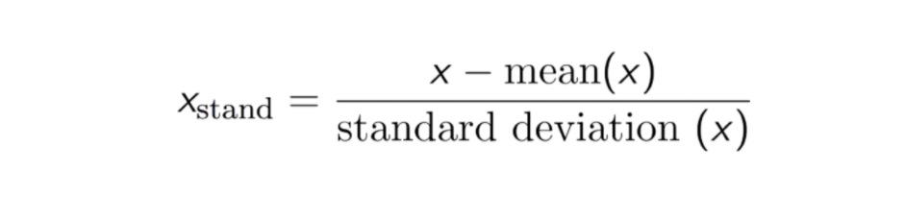
Standardisation (Z-Score Normalization)
The result of standardization (or Z-score normalization) is that the features will be rescaled to ensure the mean and the standard deviation to be 0 and 1, respectively. The equation is shown below:

Slide 6
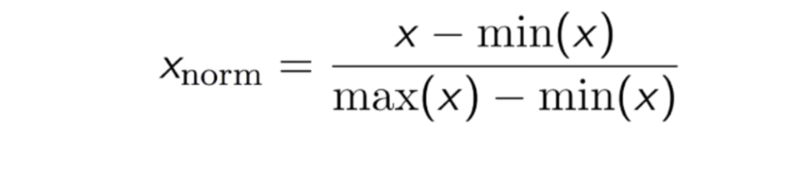
Max-Min Normalization (Max-Min Scaling)
Another common approach is the so-called Max-Min Normalization (Min-Max scaling). This technique is to re-scales features with a distribution value between 0 and 1. For every feature, the minimum value of that feature gets transformed into 0, and the maximum value gets transformed into 1. The general equation is shown below:

Slide 7
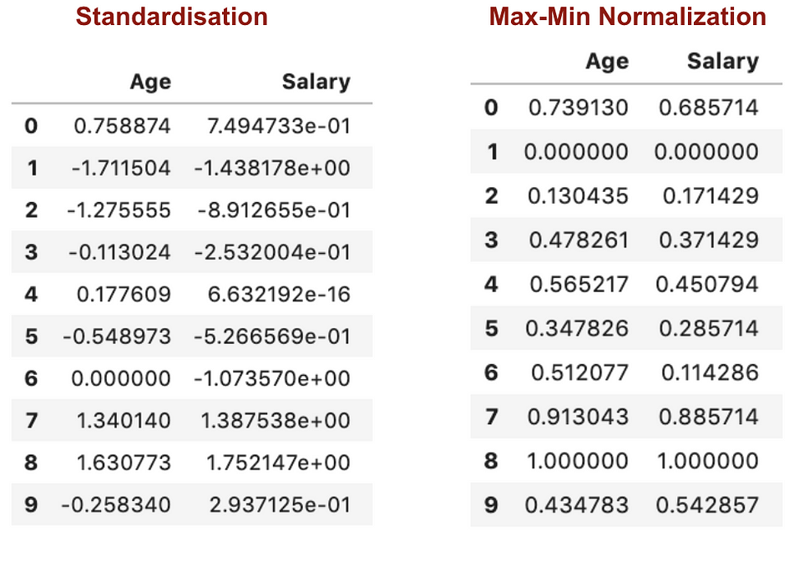
Example

Slide 8
Normalization Vs Standardisation
Applying Max-Min Nomaralisation in our dataset has generated smaller standard deviations (Salary and Age) than using Standardisation method. It implies the data are more concentrated around the mean if we scale data using Max-Min Nomaralisation.
If you have outliers in your feature (column), normalizing your data will scale most of the data to a small interval, which means all features will have the same scale but does not handle outliers well. Standardisation is more robust to outliers, and in many cases, it is preferable over Max-Min Normalisation.

Slide 9
When Feature Scaling Matters?
Some machine learning models are fundamentally based on distance matrix, also known as the distance-based classifier, for example, K-Nearest-Neighbours, SVM, and Neural Network.
Feature scaling is extremely essential to those models, especially when the range of the features is very different.
Otherwise, features with a large range will have a large influence in computing the distance.

Slide 10
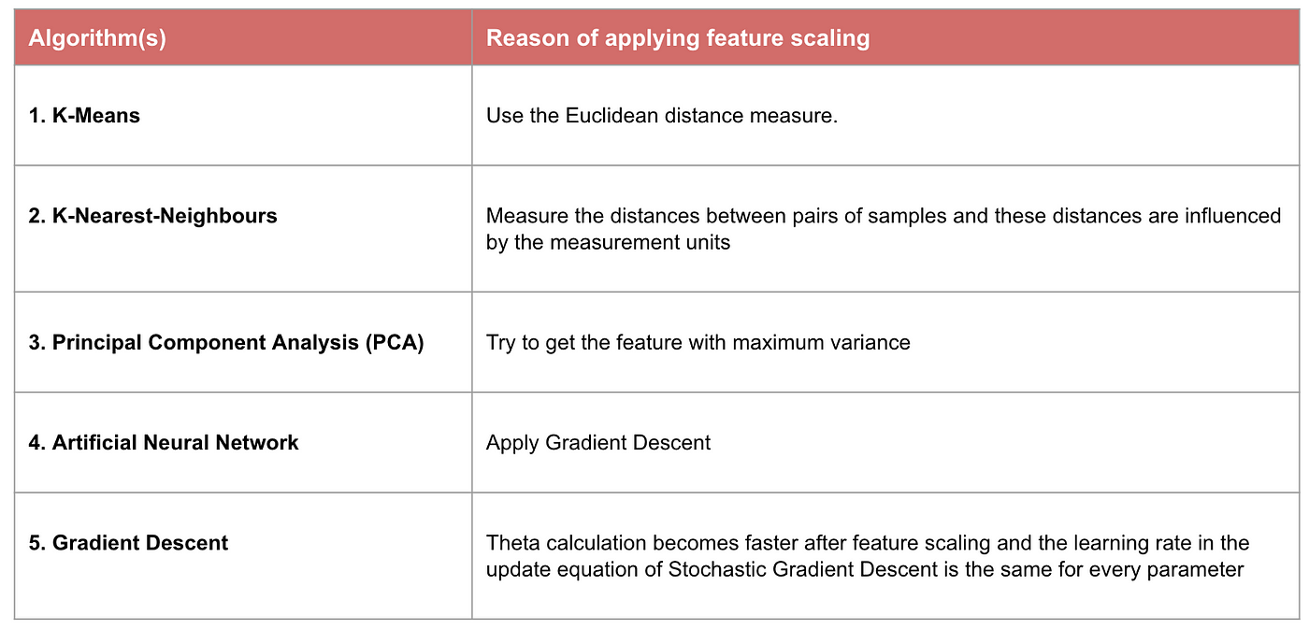
When Feature Scaling Matters?

